Slide 1
Bangla Product Review Sentiment Analysis
Group - 16
Group Members
Koushik Roy (0122230054)
Md. Golam Sarwar-E-Azam (0122230008)
Abdus Shamim Sabuj (0122230034)
Md Arafat Islam Khan (012222043)

Slide 2
Problem Formulation
“Bangla Product Review” dataset has 1 feature column that contains review comment about different products in “Bangla” & the source of this data is online e-commerce platforms. This dataset has a label column that tags each review comment as positive, negative & neutral. The objective of our project is to train ml models using the existing review data, so that it can effectively classify reviews into positive, negative & neutral class if new reviews are passed through the model.

Slide 3
Methodology
Data Initial Processing
Preprocessing
PCA
Model
Decision Tree
Logistic Regression
Ensemble Model
KNN
Neural Network
DNN
RNN
Dataset 1
Dataset 2
Dataset 3
Data Balancing
Word to Vec
Dimensionality Redection
Ploting in 2D
Observe Data Separation
Majority Voting
Aggregated Dataset

Slide 4
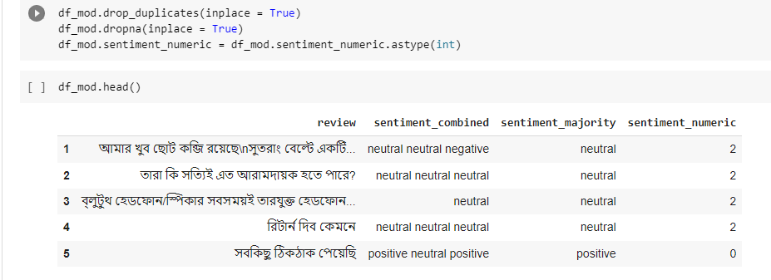
Data Initial Processing
Our main dataset contains Review (Bangla sentences) Sentiment (Positive, Negative or Neutral) Dataset length (number of row = 588) Three different persons labelled it We aggregated the labels by majority voting and create a combined dataset

Slide 5
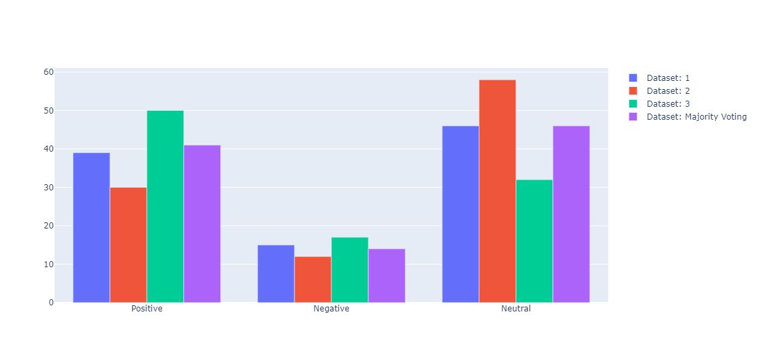
Dataset Output Ratio Plot
Figure: Dataset output in terms of percentage and comparison after majority voting

Slide 6

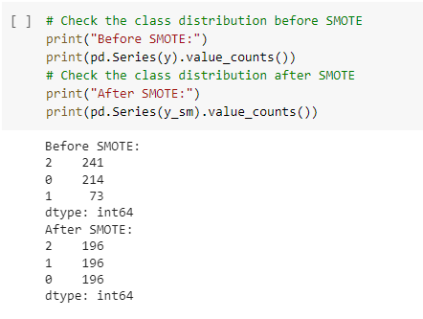
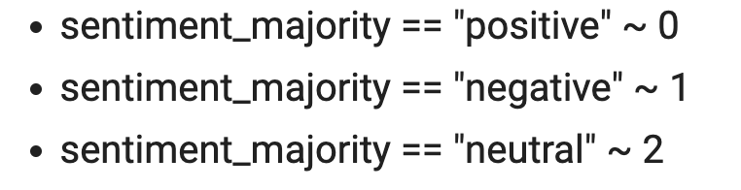
Data preprocessing (Data Balancing)
SMOTE (Synthetic Minority Oversampling Technique) Under sampling Over sampling

Slide 7
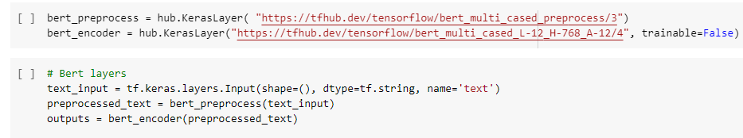
Data preprocessing (Word to Vec)
Model | Output Size
BERT multilingual base model (cased) | 768
Distill Bert Multilingual | 768
Bangla Bert | 768
Text Embedding ADA | 1536

Slide 8
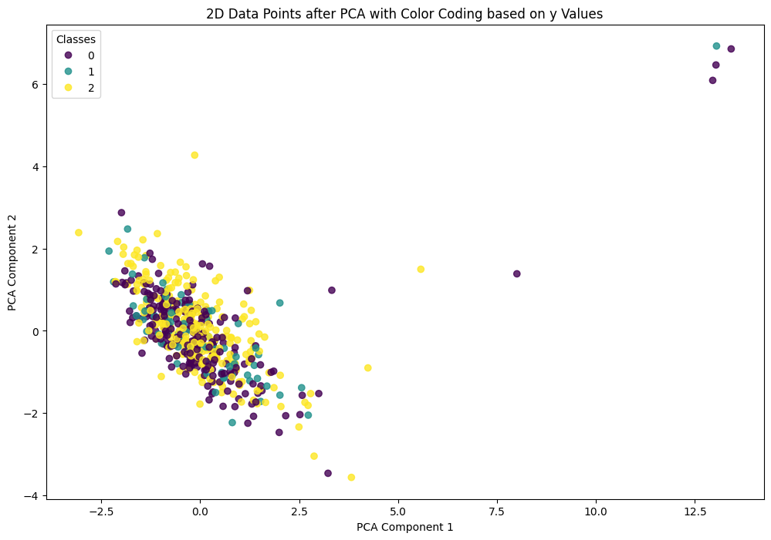
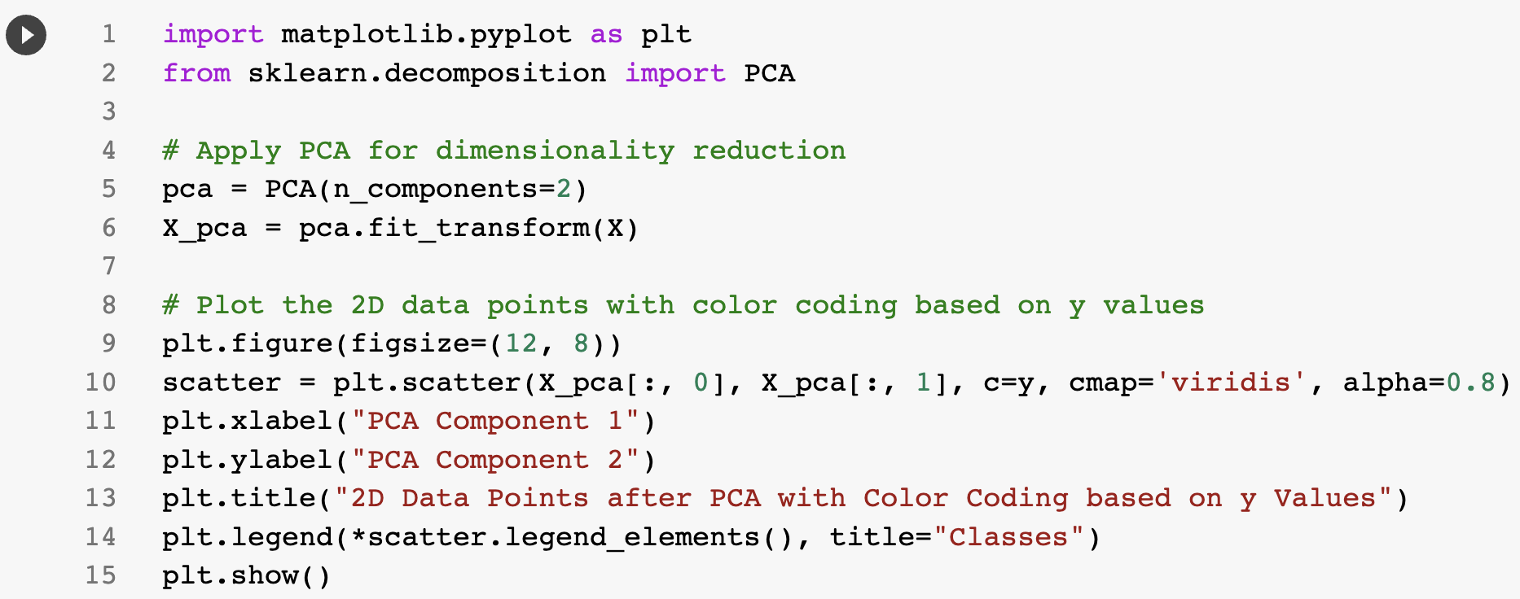
PCA
- PCA (Principal Component Analysis) - PCA was used to visualize the data (dimensionality reduction) & to Identify separation in the dataset

Slide 9
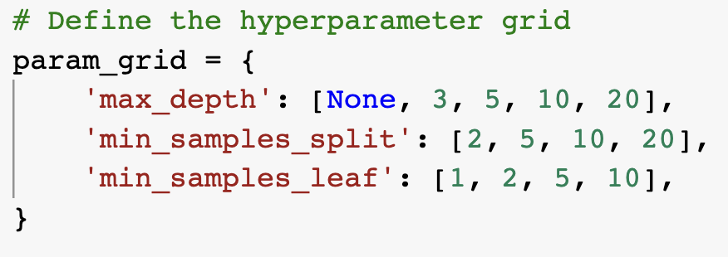
Model (Decision Tree)
Decision Tree Hyperparameter optimization in DT using grid search Best hyperparameters: {'max_depth': None, 'min_samples_leaf': 1, 'min_samples_split': 10} Test Accuracy (tuned): 0.40566

Slide 10
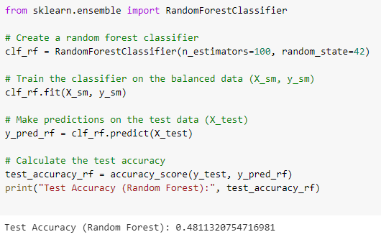
Model (Random Forest)
Random Forest Test Accuracy 48%

Slide 11
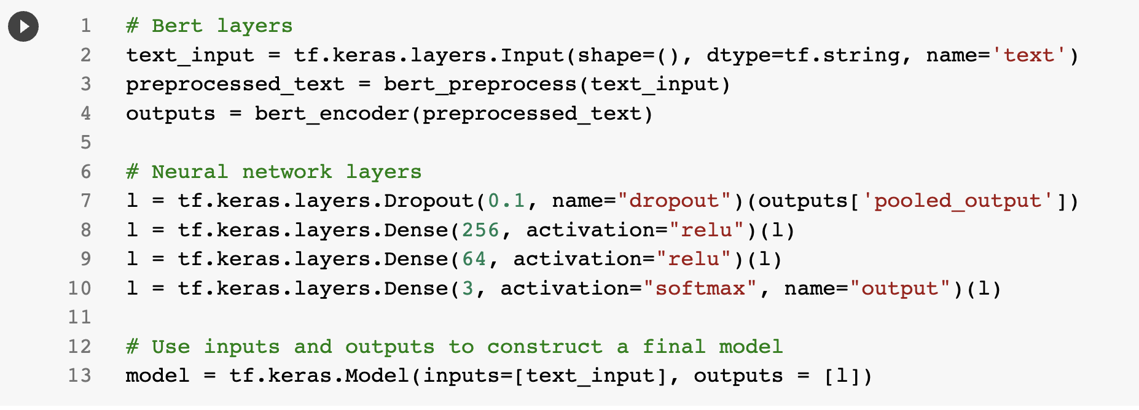
Model (Dense Neural Network)
Neural Network Architecture

Slide 12
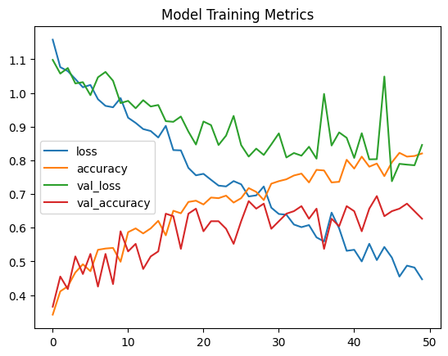
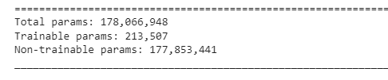
Model (Dense Neural Network)
Dense Neural Network Test Accuracy 51%

Slide 13
Model (Planned to Evaluate)
Logistic Regression KNN Check for different values of k for finding the best one Using different type of distance measure Euclidean distance Cosine similarity Ensemble Methods Voting classifier Adaboost RNN Based Neural Network

Slide 14
Thank You

